Slide 1



Facial Expression Recognition
Khandokar Shafkatuzzaman
ID - 1520697042
Section - 1
Course - CSE465

Slide 2
Introduction
An Facial Emotion Recognition System compromises of two step process i.e. face detection in image followed by emotion detection on the detected bounded face.
The Following two techniques are used for respective task:
Haar feature-based cascade classifiers It detects frontal face in an image well. It is real time and faster than other face detector. (Open-CV)
Xception CNN Model I trained a classification CNN Model Architecture which takes bounded face (48*48 pixels) as input and predict probabilities of 7 emotions in the output layer.

Slide 3

Data-Set
I have downloaded the Facial Expression Recognition data-set from Kaggle.
The data consists of 48*48 pixel gray scale images of faces.
The faces in the data-set is more or less centered and occupy the same amount of space in image.
The training set consists of 35,888 examples. And the csv file contains two columns “emotion” and “pixels”
The emotion columns contains a numeric code ranging from 0 to 6.

Slide 4
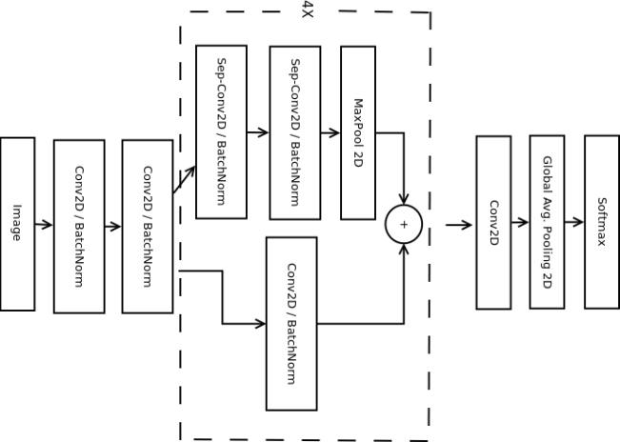



Training CNN model : Mini Xception
Below are few techniques which are used while training the CNN model:
Data Augmentation More data is Generated using the training set by applying transformation like rotation, crop, shifts, shear, flip, zoom etc.
Kernel_regularizer It allows to apply penalties on layer parameters during optimization.
BatchNormalization It normalizes the activation of the previous layer at each batch.
Global Average Pooling It reduces each feature map into a scalar value by taking the average over all elements in the feature map.
Depthwise Separable Convolution It reduces the computation with respect to the standard convolutions by reducing the number of parameters.
The below architecture was proposed by Octavio Arragia
You can notice that Center Block here is repeated 4 times.
This architecture is different from the most common CNN architecture.
Common architectures uses fully connected layers at the end where most of parameters resides and use standard convolutions.
But this Mini Exception CNN model have two most successful experimental assumptions: The use of residual modules and depth-wise separable convultions.
B
Tools Used:
Python
Tensorflow (as Backend)
Keras
OpenCV
IMutils
A

Slide 5
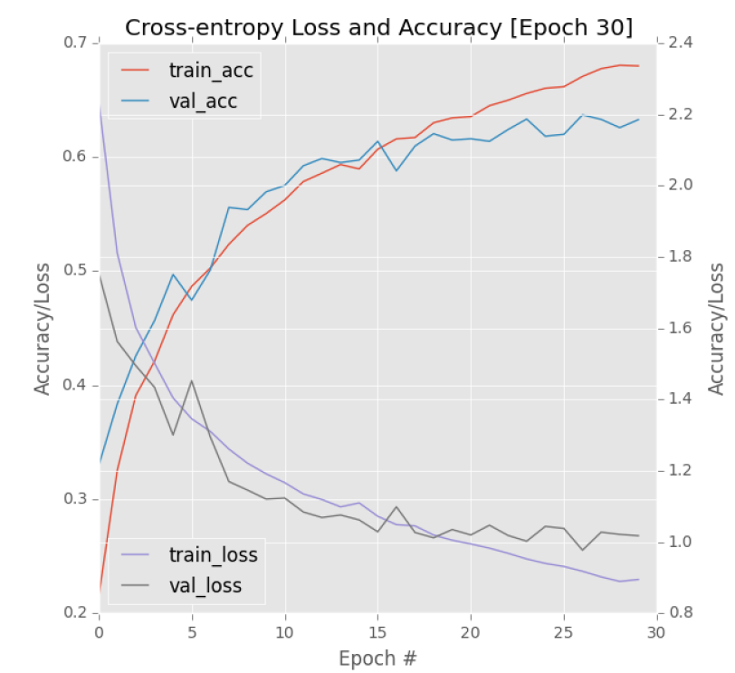

Testing the Model
While performing tests on the trained model, I felt that model detects the emotion of faces as neutral if the expression are not made distinguishable enough.
Train Accuracy: 77%
Validation Accuracy: 69%
Train Loss: .15
Validation Loss: .22
Here is the graph of 30 Epochs

Slide 6
THANK YOU

